Slide 1
Learn How to Create your own
Tableau Report

Slide 2
Demo
How to build text table
How to build Graph/Charts
How to build a basic dashboard
How to download an existing report and change it and much more

Slide 3
Tips for creating Effective Dashboard
Choose the metric that matter
Keep it visual
Make it interactive
Make it simple to access and use
Notes:
Be highly selective in determining which metrics earn a spot on the dashboard.
Dashboards are meant to be fast and easy to read. Report and text-based tables are not fast or easy to read.
The easier and more intuitive you make the process of customization, the more likely they will be to use your dashboard.

Slide 4
Navigation Tips
Left to right, Top to down
Drill from higher to lower detail
Drill from higher to lower importance

Slide 5
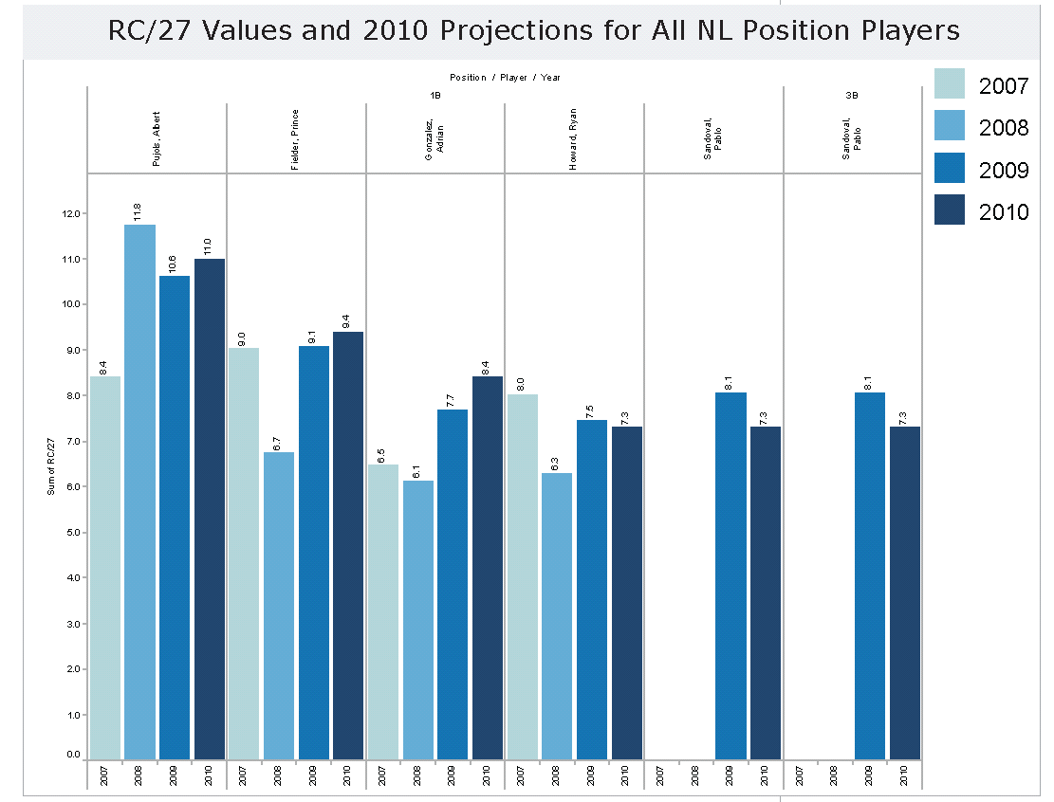
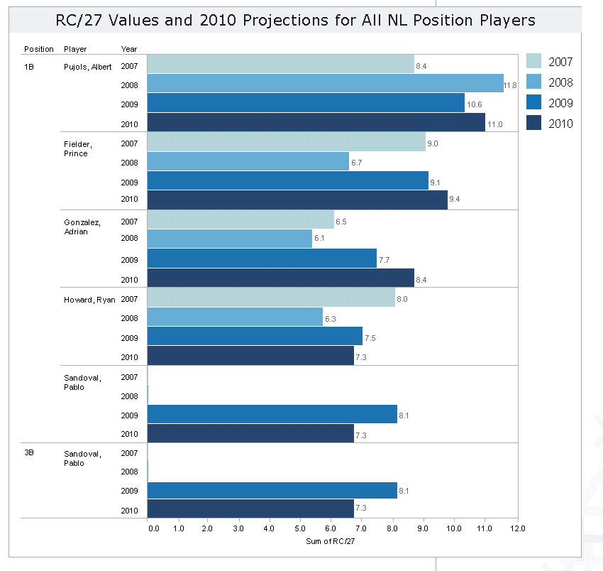
Tableau Design Tips
Orientation
Notes:
Orientation: Vertical vs horizontal orientation

Slide 6
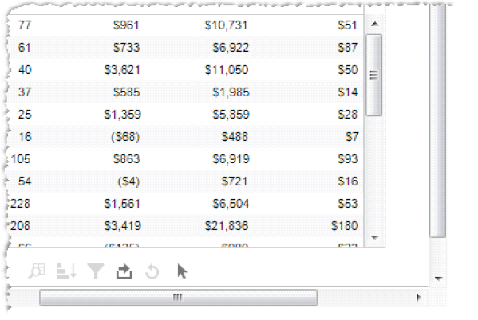
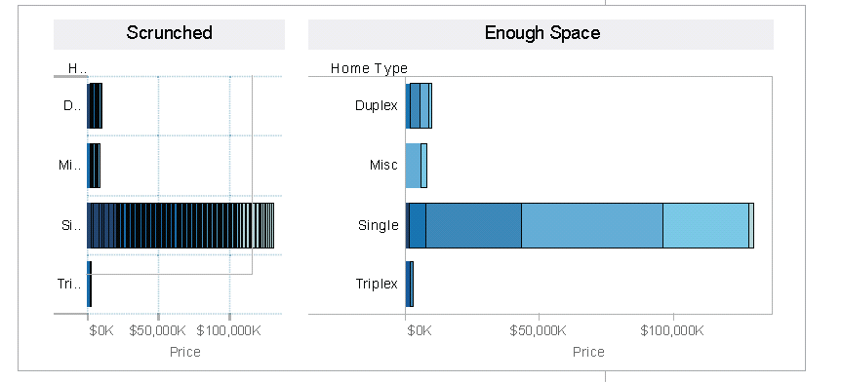
Tableau Design Tips
Sizing - Make sure Viz is visible
Notes:
Sizing: Making sure viz is visible. Be careful that views are not being scrunched so much that there not enough room to read headers or understand the data.

Slide 7
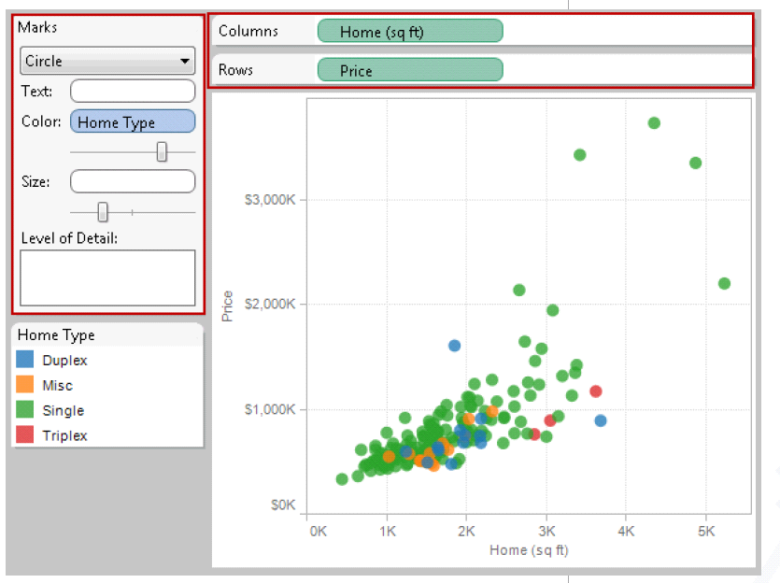
Tableau Design Tips
Emphasize most important data
Notes:
Emphasize the most important data: In all vizes, make sure to have the most important data on the row or column shelves. Less important data should be encoded in color, size, shape, etc.

Slide 8
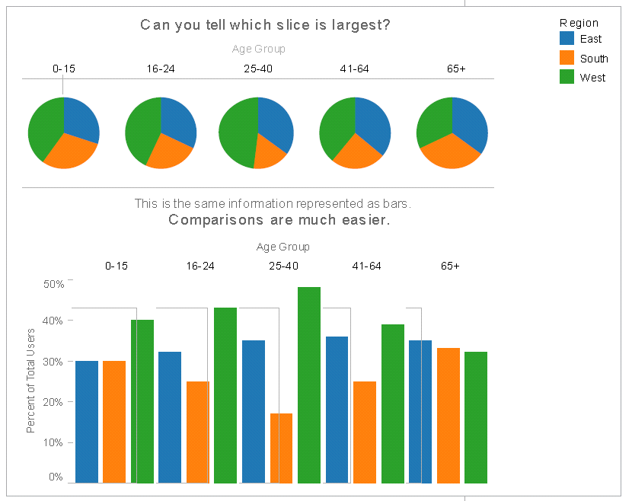
Tableau Design Tips
Pie Charts - where NOT to use them

Slide 9
Visual Tricks
Select and zoom on data
Include or exclude data points
View the data behind the charts
Download the data

Slide 10
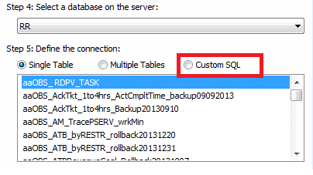
Tableau Performance Tips
Data Sources – Avoid Custom SQL
Removed unused Data Sources
Notes:
Tableau will be able to optimize its queries when using Multiple Tables.

Slide 11
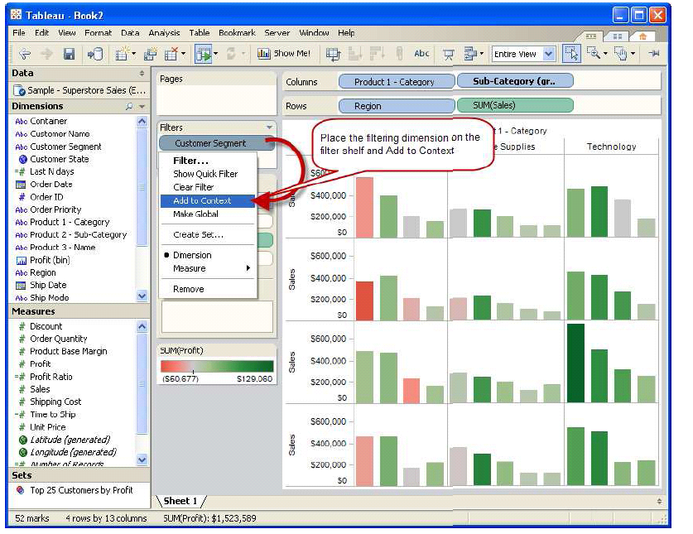
Tableau Performance Tips
Add context filter for relevant data
Notes:
If we know that we are going to be filtering on select subset of data , say specific customer segment, place the filtering dimension on the filter shelf and then add to context , so
That all further results will be pre- filtered and proportionately faster.

Slide 12

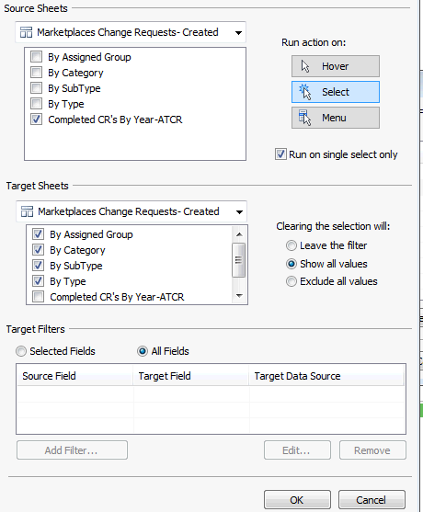

Tableau Performance Tips
Use Filtering actions instead of quick filters.
Notes:
A quick filter needs a query in order to populate the list for the filter whereas action leverages the view itself as filtering agent and saves query rerun.

Slide 13
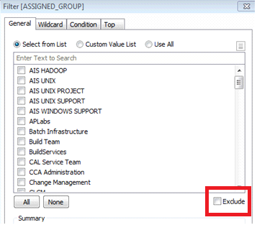
Tableau Performance Tips
Try to Avoid ‘Exclude’ option while filtering data
Notes:
Tableau must scan all the selected data which is expensive while using Exclude option, only use when needed.

Slide 14
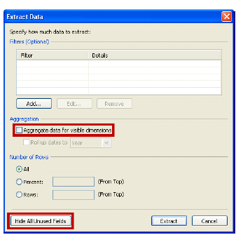
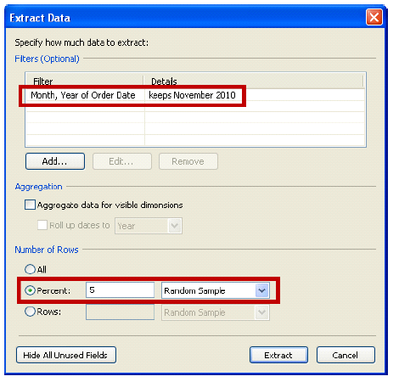
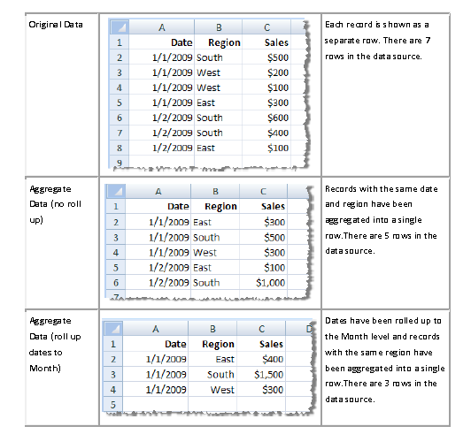
Tableau Performance Tips
Extracts
Hide unused fields
Extract subset of data -Aggregate visible dimension
Notes:
Tableau will only extract unhidden fields ,Tableau can create extract that is aggregated to the level that is needed. Also can select the no of rows that will go into the extract.

Slide 15
Tableau Performance Tips
Use Boolean calculations
IF [Date] = TODAY() THEN “TODAY”
ELSE “NOT TODAY”
END
[Date]=TODAY() then use alias to rename true and false results to Today and Not Today
Use calculated fields instead of adhoc grouping
Notes:
Boolean are faster than IF THEN ELSE statement that returns only two values , then use aliases to rename true and false
A case statement is much faster than an creating an group and moreover if new data matches with the existing condition on a case statement ,it will automatically group it.

Slide 16

Tableau Best Practices
Usage of data extracts instead of live connections
Tune queries on the Database
Join table or data blending
“Replace data source” while changing environment
Notes:
Go for Data Extracts – Unless you need instant updates, don't be limited by speed of the data source.

Slide 17


